Slide 1

Heart Risk Prediction Through Logistic Regression Model
Kimberly Stein, MS
MS Data Analytics - Data Science
Western Governors University
March, 2025

Slide 2
About the Author
Kim Stein
Completing MS in Data Analytics - Data Science
MS in Health Promotion and Education
Background: Public Health, Health Sciences Education, Secondary Education, Healthcare

Slide 3
Introduction
According to the Centers for Disease Control, heart disease is the leading cause of death in the United States (CDC, 2024).
Predicting heart disease and heart attack risk enables early intervention and preventive measures.
Identifying individuals who are high risk can save patients and providers valuable time and resources.

Slide 4
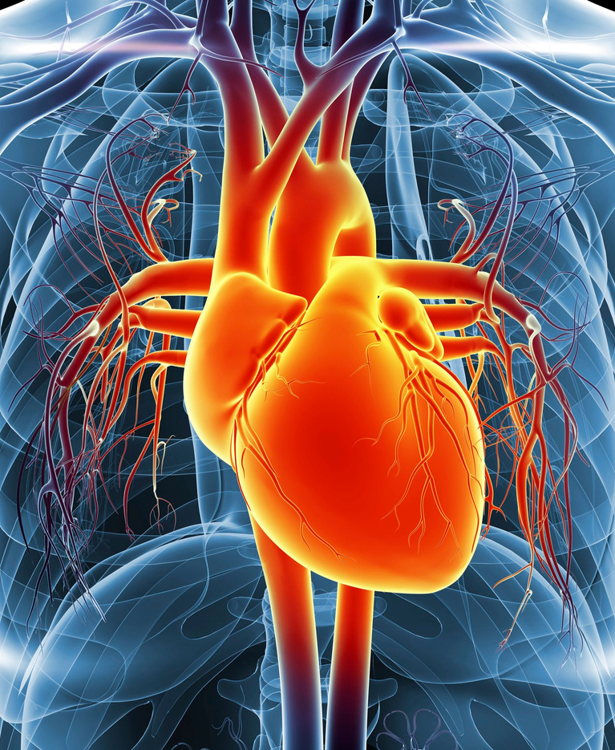
Research Question and Hypothesis
Heart Risk Prediction:
Research Question: To what extent do age, BMI, and health risk factors (tobacco use, sleep, physical activity, and alcohol use) affect the risk of heart attack?
Hypothesis: Age, BMI, and health risk factors have a statistically significant effect on heart attack risk.
If the hypothesis is correct, then we can use these demographics to predict whether patients are at risk.

Slide 5
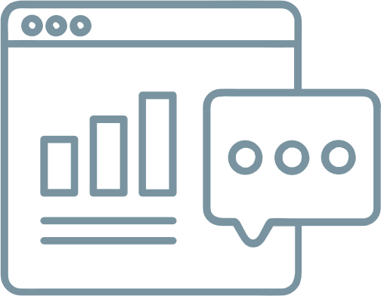
Steps in Data Analysis
Data Collection
I obtained the data from the CDC 2022 Behavioral Risk Factor Surveillance System (BRFSS) public data set (CDC, 2023)
Data Exploration and Analysis
I used visualizations to explore the data, created training and testing data sets, used logistic regression for the analysis because the target prediction variable (whether someone is at risk) is binary (1 or 0)
Data Preparation
I selected appropriate variables, then explored and cleaned the selected variables to prepare for analysis, including removing missing data and outliers and calculating BMI

Slide 6



Data Analysis Model Creation
Logistic Regression Model
Stepwise Regression
Test model performance
Model created using selected variables: biological sex, age group, general health rank, BMI, smoking status, e-cigarette use, alcohol use, exercise, hours of sleep, and heart risk.
Stepwise regression tests whether each variable is useful in training the model and recommends removal of variables if necessary.
This process recommended using all selected variables.
Test model using test data set (created prior to model).
This provides unseen data to the model to determine how accurately it predicts risk.

Slide 7
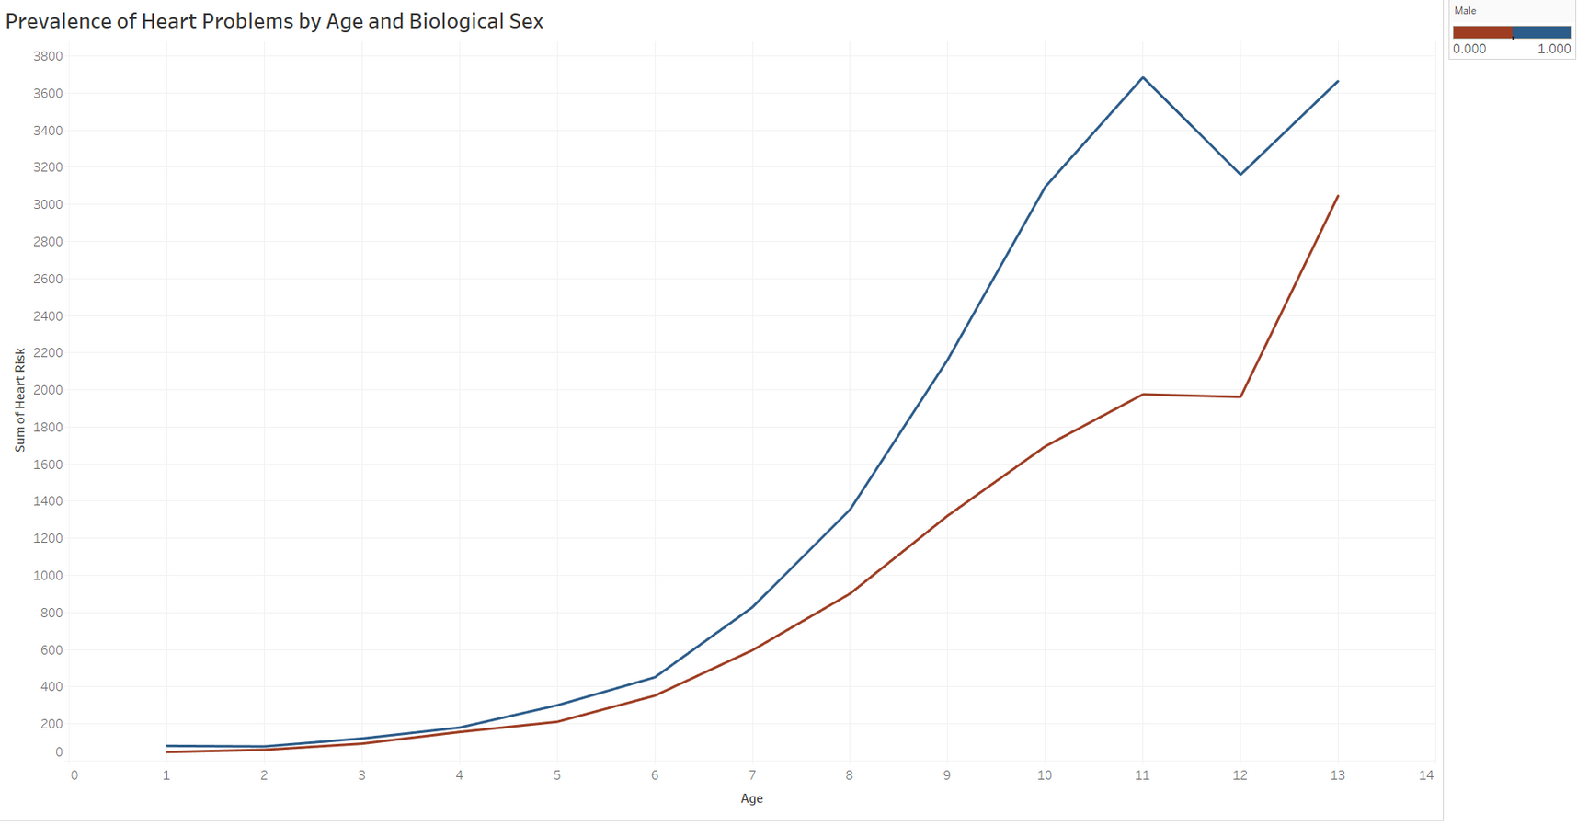
Data Exploration

Slide 8
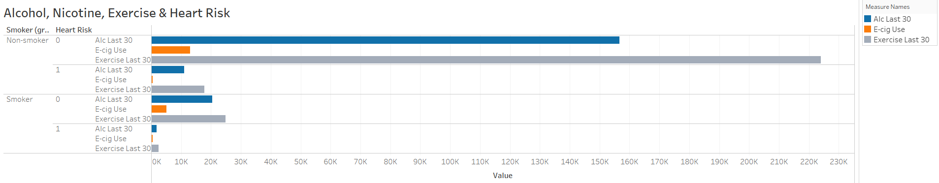
Data Exploration
Increased Risk:
Substance Use and Exercise:
Previous slide shows:
Risk increases with age.
Higher risk in males than females.
No clear patterns in substance use and exercise affecting risk.
Much higher prevalence of non-smokers than smokers in data set.

Slide 9
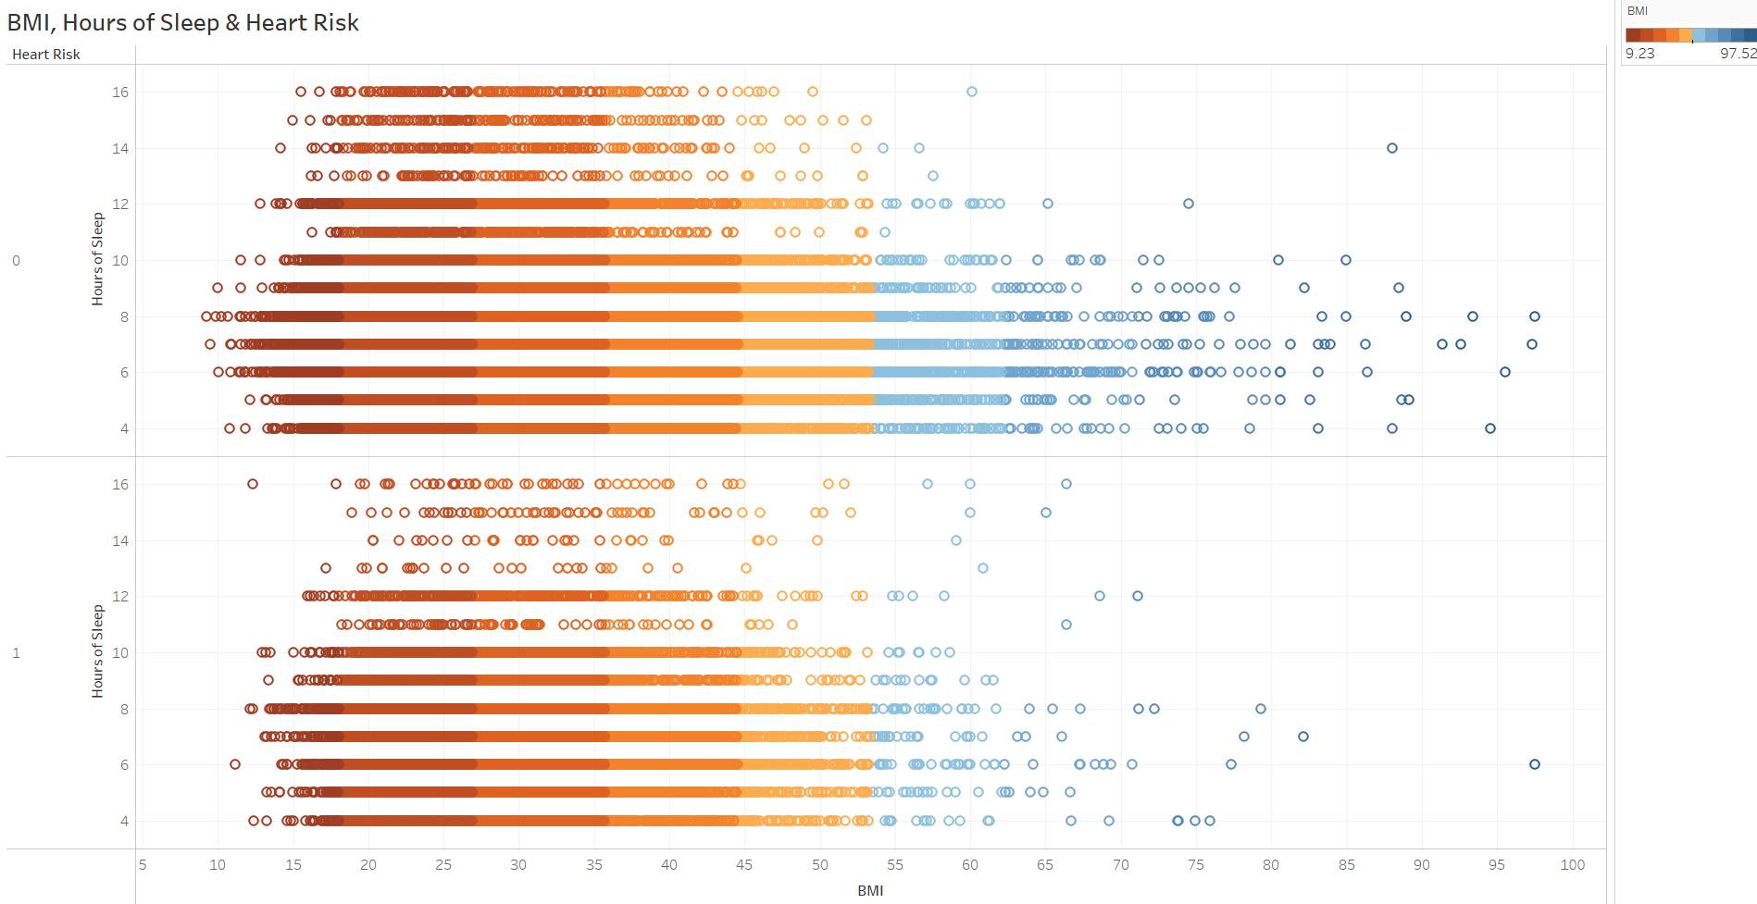
Data Exploration

Slide 10
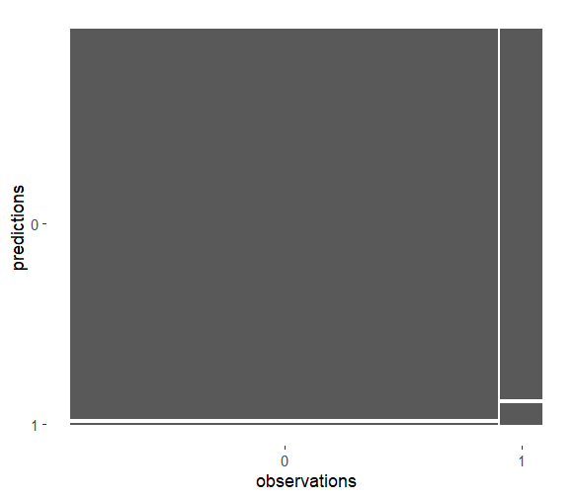

Results of Analysis
Accuracy:
Testing compares model predictions with actual values in the test set
Model predicts risk with 90.9% accuracy
More likely to give false negative than false positive
Confusion Matrix:
1 is positive, 0 is negative
Large proportion of participants with no risk
Very few false positive predictions

Slide 11
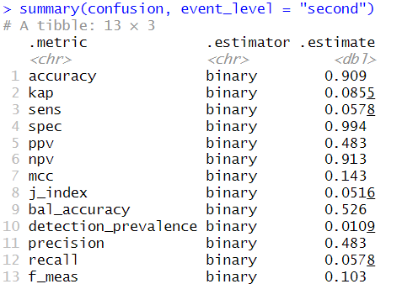
Limitations
Logistic regression limitations:
Logistic regression assumes a linear relationship between the log odds of the variables, so it may not capture non-linear patterns
Logistic regression is sensitive to outliers, which is why the data-cleaning process is so important
This regression model is sensitive to irrelevant variables, which is why stepwise regression was used to verify the inclusion of all variables
Model limitations:
The model produced a higher number of false negatives than false positives
Precision (ability of model to correctly predict positive class) is 48%
Sensitivity (proportion of true positives) is 58%
If a patient is predicted not to have risk but has high-risk health factors, discussions with their medical team could still be important for prevention of heart problems

Slide 12

Recommendations for Use
Healthcare providers can use the model to create predictions for patients while bearing in mind that it can provide false negative predictions
Discuss applicable risk and preventative factors to protect patient health
Model produced few false positives, so if a patient is predicted to be at risk, they likely are at high-risk for heart attack or coronary heart disease
Implementation of model must accompany care and follow-up with medical care from licensed professionals

Slide 13

Future Use of Model and Data
Original dataset contained 328 variables, including other chronic diseases, so it could be used to predict other types of chronic illness among patients
Using analysis to predict disease can help patients who do not have the means to undergo genetic testing to determine risk
Increasing the number of independent variables could improve model performance

Slide 14
Benefits of Study
This model correctly predicts participant risk of heart attack or heart disease 90.9% of the time.
The prediction model can be used by medical professionals to help identify patients that are high risk for heart problems and implement prevention plans for them, saving the patients and providers time and resources.

Slide 15
Citations
Centers for Disease Control. (2023, November). 2022 BRFSS Survey Data and Documentation. CDC. Retrieved March 7, 2025, from https://www.cdc.gov/brfss/annual_data/annual_2022.html
Centers for Disease Control. (2024, December 11). Leading Causes of Death, United States. CDC. Retrieved March 12, 2025, from https://www.cdc.gov/womens-health/lcod/index.html

Slide 16
Thank you

